Slide 1
CNN Training Progress
Ankush Patel - CS494 - Week 2

Slide 2
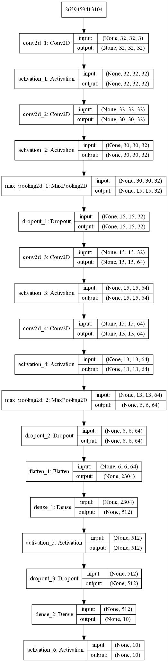
New Model
Added 2 dropout layers
Added an additional max pooling layer
Added 3 more convolutional layer
Notes:
Dropout layers allow the model to not overfit the data
Max pooling reduces the amount of data required to be processed
Convolutional layers conserve spatial information

Slide 3
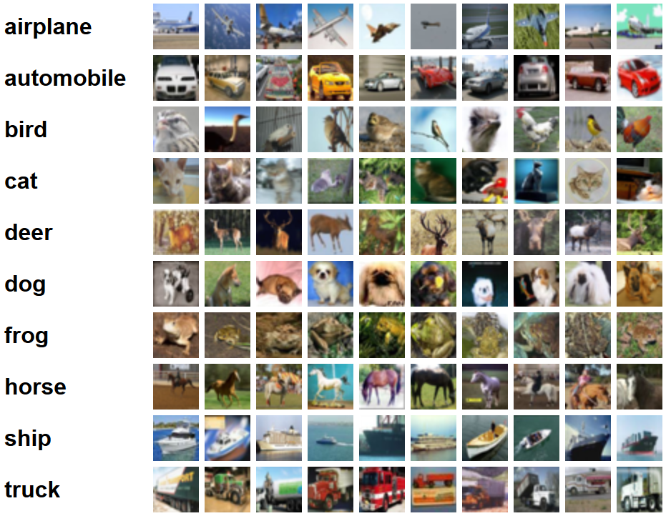
CIFAR-10
Notes:
http://www.cs.toronto.edu/~kriz/cifar.html
60000 32x32 images with 10 classes
Purpose:
A more consistent image dataset
Less time training due to smaller images

Slide 4
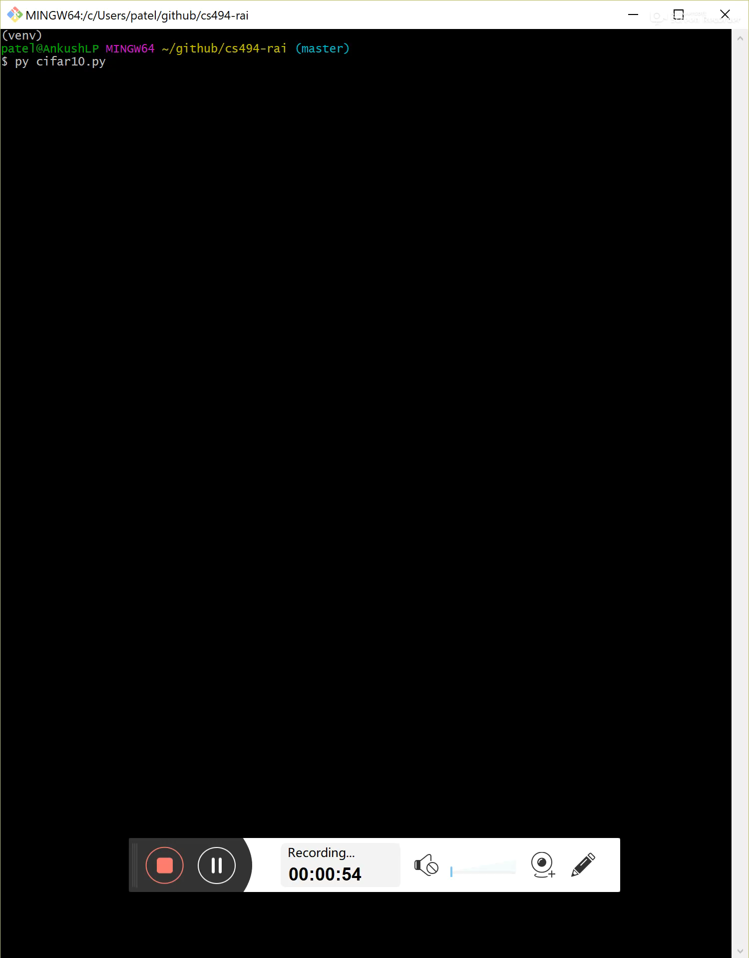
Training
For both cats/dogs and birds/frogs training took 1 hour and 41 minutes
For the combined model training took 3 hours and 25 minutes
Training was conducted on an Intel Core i7-8550U CPU
Notes:
The video shows training for one epoch

Slide 5
Testing
After 100 epochs, the cats vs dogs model showed an accuracy of 0.8285 for its respective test set
Similarly, the birds vs frogs model showed an accuracy of 0.9210 and the combined model showed an accuracy of 0.7968
Notes:
I believe that the birds vs frogs model had a higher accuracy because they have much more distinct features than cats vs dogs
The combined model’s smaller accuracy shows that the CNN may be overfitting data and not generalizing well.

Slide 6
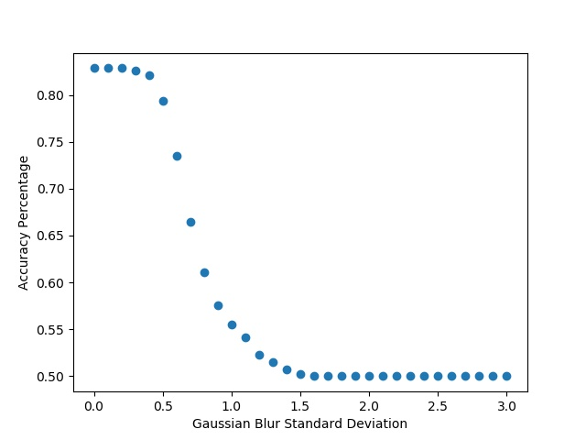
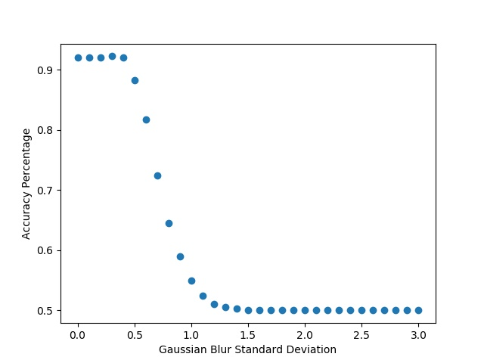
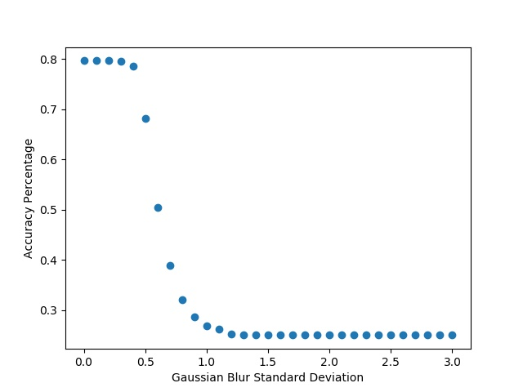
Gaussian Blur Effects on Accuracy
Cats vs Dogs
Birds vs Frogs
Combined
Notes:
The humps we observed last week have disappeared – I think that’s due to the fact that the images are much smaller 64x64 → 32x32 and/or might have been filtered before hand.
Notice the small hump present in birds vs frogs → this might be due to the fact that most of the images are outside
The combined model appears to drop in accuracy much more quickly than the individual models

Slide 7
Future
Future dataset: ImageNet
Train on noisy images
Out of the 10 suggest 4 distinct images and train / compare
Show that the hump does not always occur with gaussian blur – navigate the resolution space [need higher resolution images]

